Slide 1
Lecture 11: Neural Networks; Design and Regularization

Slide 2
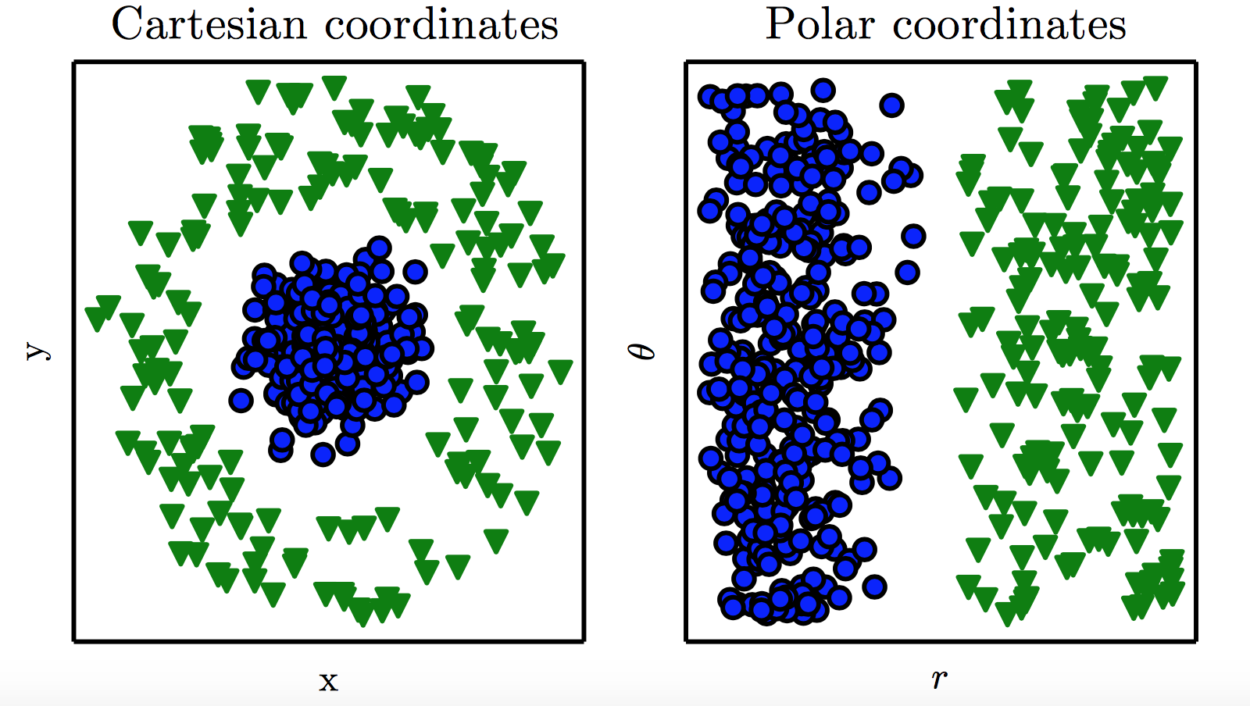
Representation
Representation Matters

Slide 3
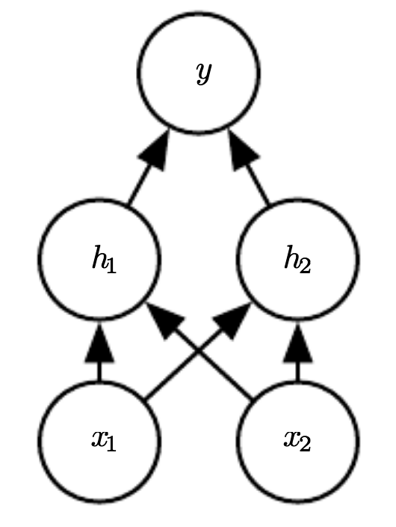
Neural Network

Slide 4
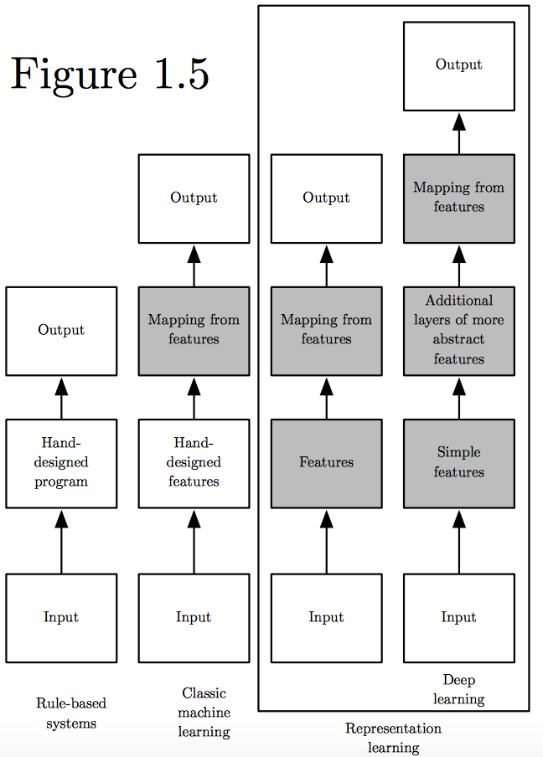
Learning Multiple Components
(Goodfellow 2016)

Slide 5
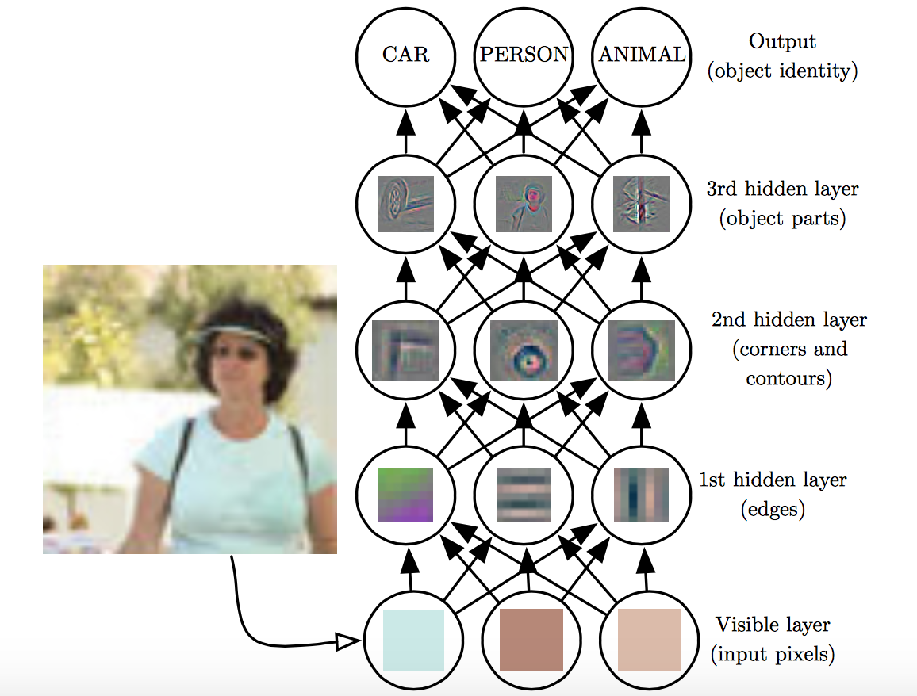
Depth = Repeated Compositions

Slide 6
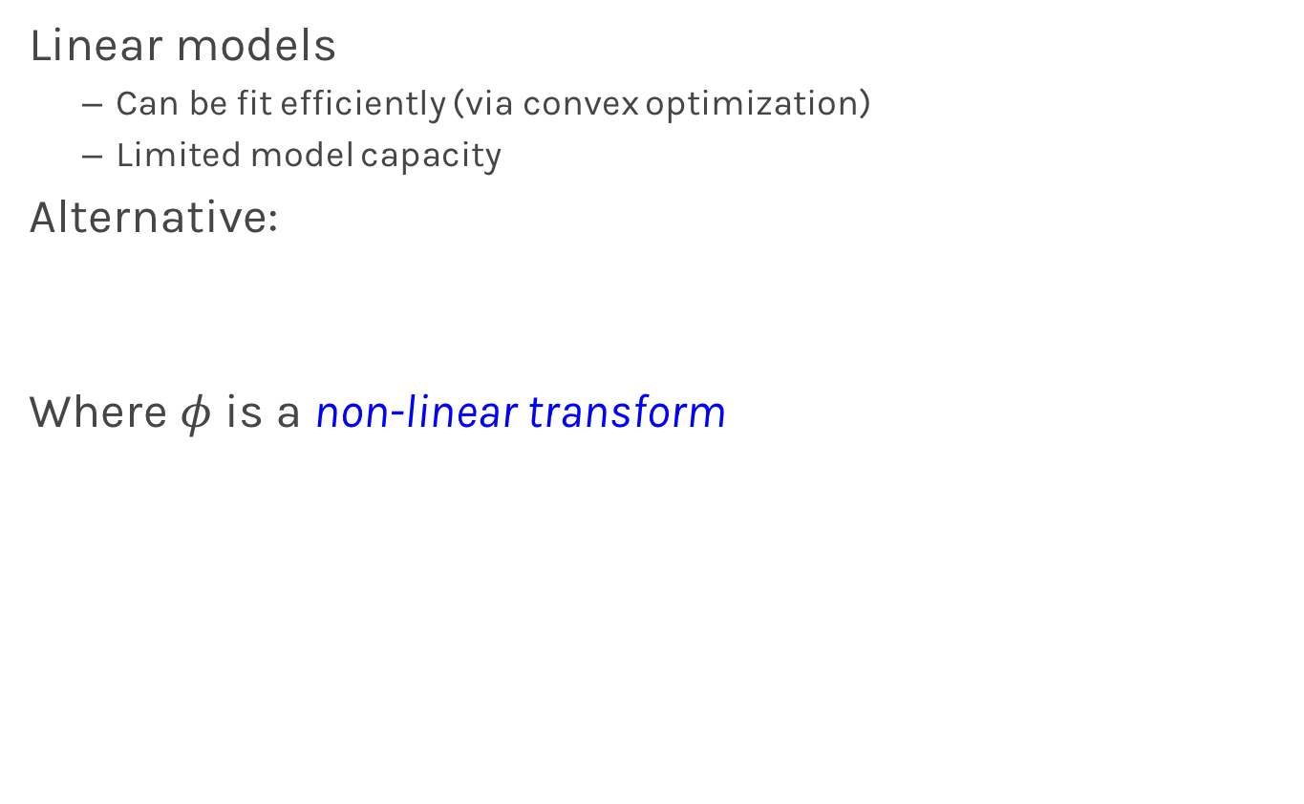
Beyond Linear Models
Linear models
Can be fit efficiently (via convex optimization)
Limited model capacity
Alternative:
Where $φ$ is a non-linear transform

Slide 7
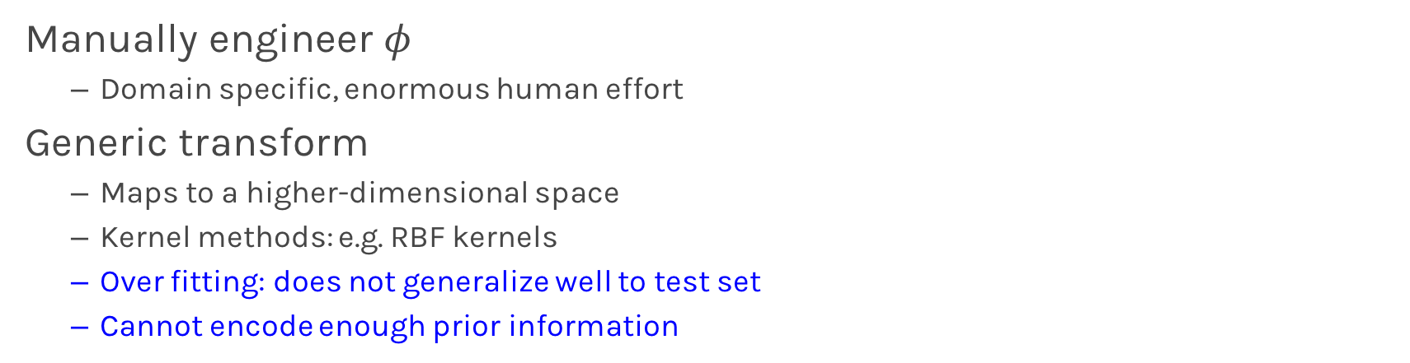
Traditional ML
Manually engineer $φ$
Domain specific, enormous human effort
Generic transform
Maps to a higher-dimensional space
Kernel methods: e.g. RBF kernels
Over fitting: does not generalize well to test set
Cannot encode enough prior information

Slide 8
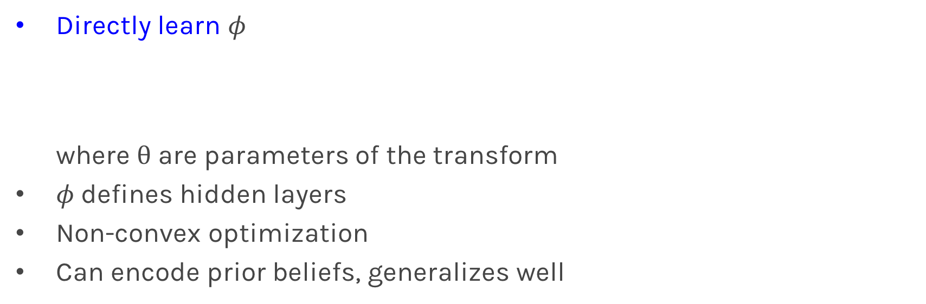
Deep Learning
Directly learn $φ$ where $θ$ are parameters of the transform
$φ$defines hidden layers
Non-convex optimization
Can encode prior beliefs, generalizes well

Slide 9
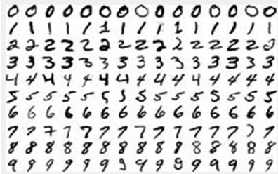
Neural Networks
Hand-written digit recognition: MNIST data

Slide 10
Example: Learning XOR
where,

Slide 11
Design Choices
Cost function
Output units
Hidden units
Architecture
Optimizer

Slide 12
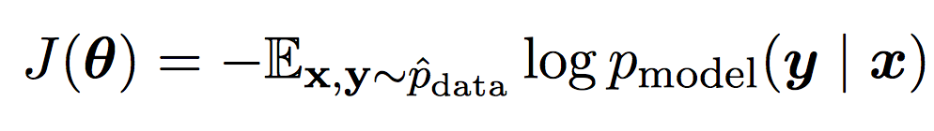
Cost Function
Cross-entropy between training data and model distribution (i.e. negative log-likelihood)
Do not need to design separate cost functions
Gradient of cost function must be large enough

Slide 13
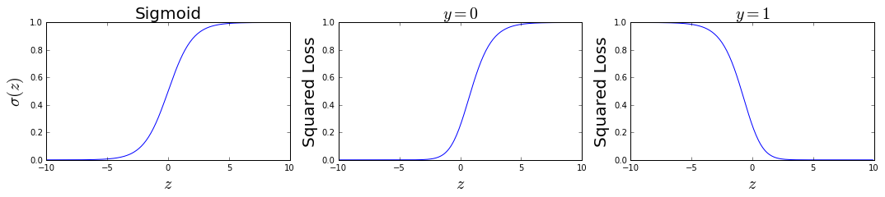
Cost Function
Example: sigmoid output + squared loss
Flat surfaces

Slide 14
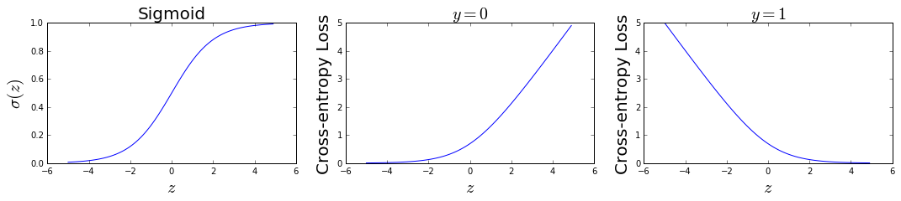
Cost Function
Example: sigmoid output + cross-entropy loss
log undoes exp
Saturates only when the model makes correct predictions

Slide 15
Design Choices
Cost function
Output units
Hidden units
Architecture
Optimizer

Slide 16
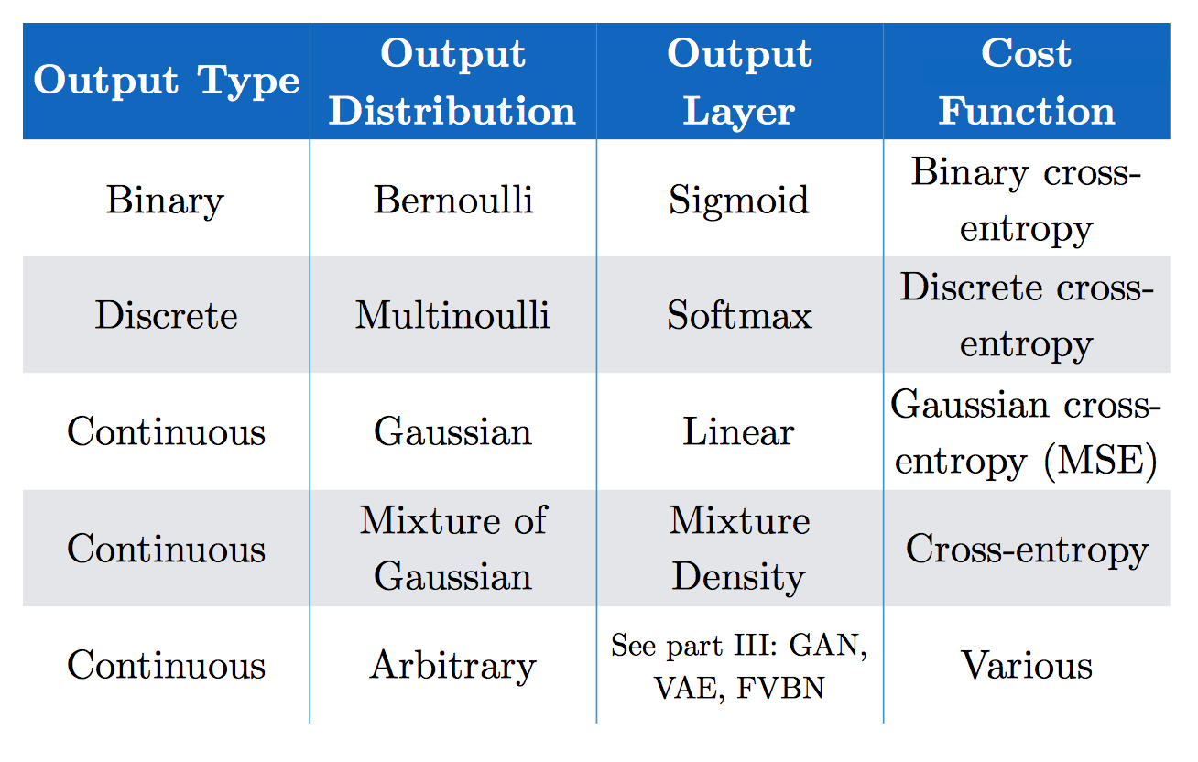
Output Units
(Goodfellow 2017)

Slide 17
Softmax Output
Discrete / Multinoulli output distribution
For output scores z₁, …, z_{n}
Log-likelihood undoes exp

Slide 18
Design Choices
Cost function
Output units
Hidden units
Architecture
Optimizer

Slide 19
Hidden Units
with activation function g
Ensure gradients remain large through hidden unit
Preferred: piece-wise linear activation
Avoid sigmoid/tanh activation
Do not provide useful gradient info when they saturate

Slide 20
ReLU
Rectified Linear Units
Gradient is 1 whenever unit is active
More useful for learning compared to sigmoid
No useful gradient information when z<0
0

Slide 21
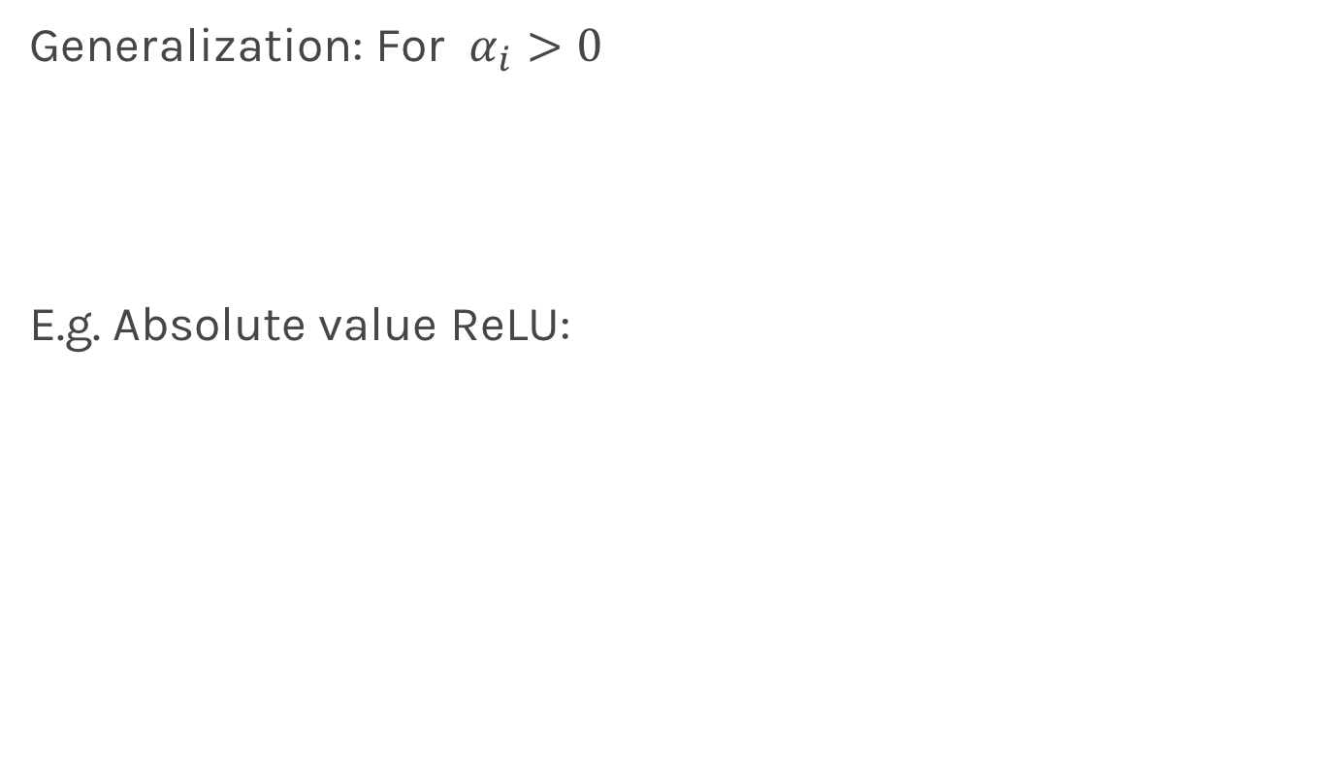
Generalized ReLU
Generalization: For $α_{i}>0$
E.g. Absolute value ReLU:
0

Slide 22
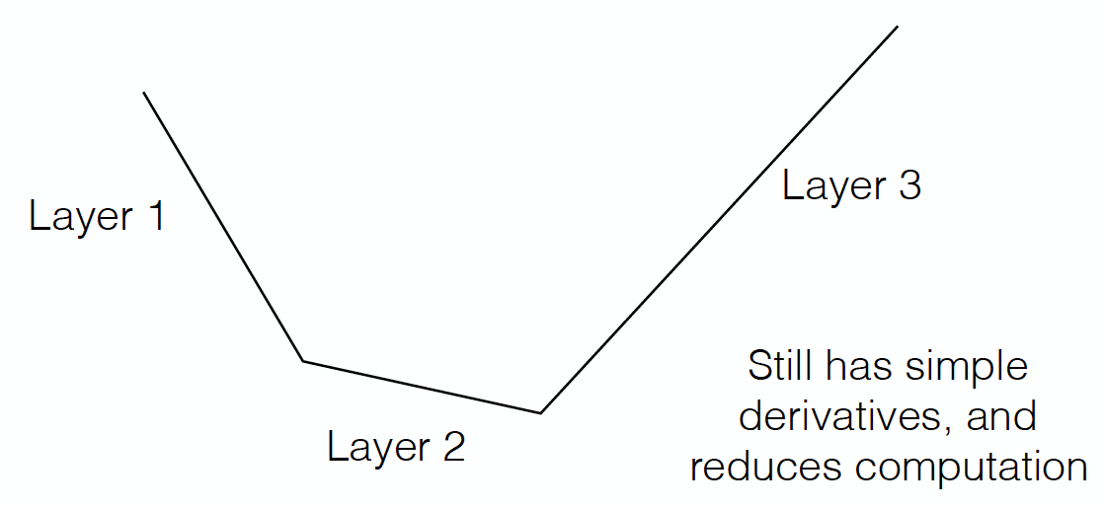
Maxout
Directly learn the activation function
Max of k linear functions
(α₁, β₁)
(α₃, β₃)
Line 3
(α₂, β₂)

Slide 23
Design Choices
Cost function
Output units
Hidden units
Architecture
Optimizer

Slide 24
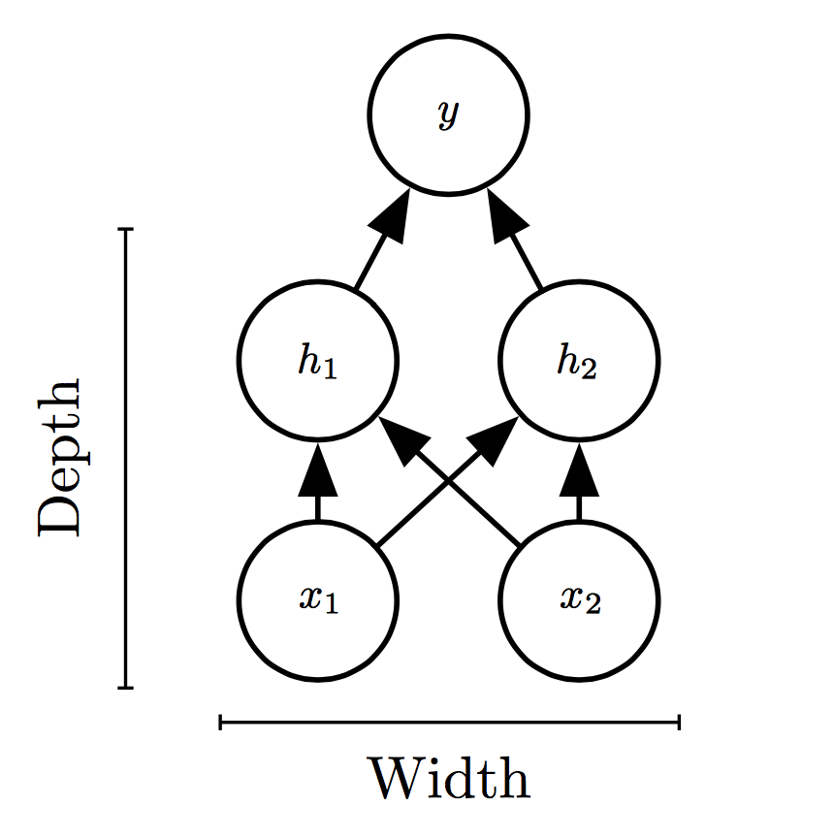
Universal Approximation Theorem
One hidden layer is enough to represent an approximation of any function to an arbitrary degree of accuracy
So why deeper?
Shallow net may need (exponentially) more width
Shallow net may overfit more

Slide 25
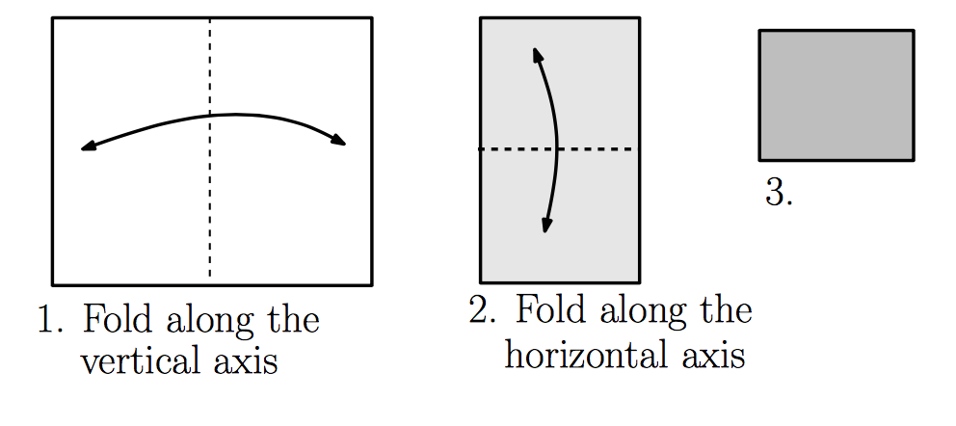
Exponential Gain with Depth
Each hidden layer folds the space of activations of the previous layer. E.g. abs activation
Montúfar (2014)

Slide 26
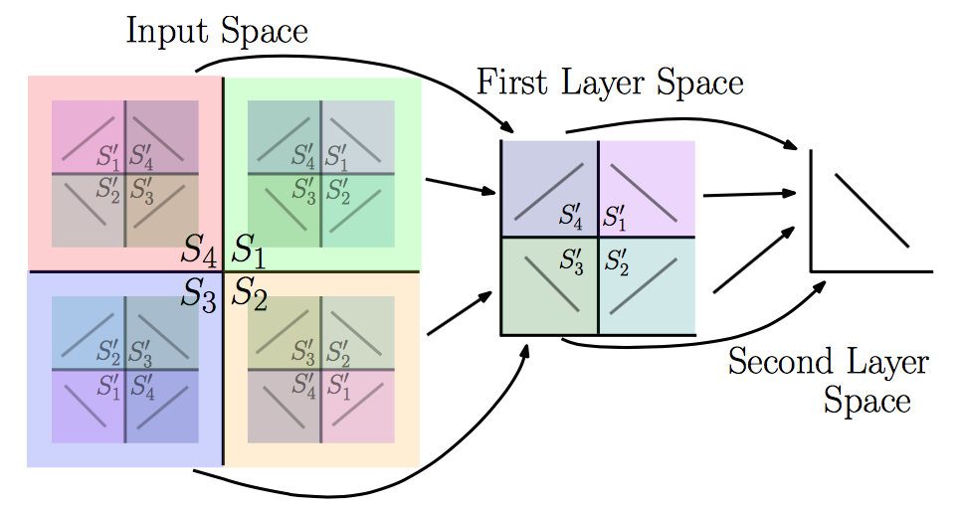
Exponential Gain with Depth
With N hidden layers, there are O(4^{N}) piecewise linear regions
Montúfar (2014)
See illustration in notebook

Slide 27
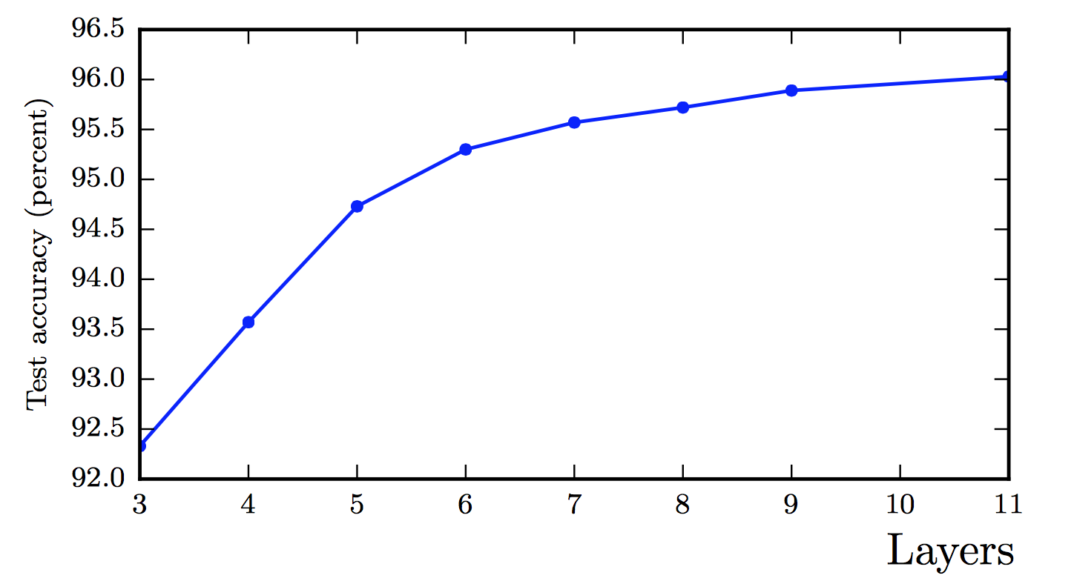
Better Generalization with Depth
(Goodfellow 2017)

Slide 28
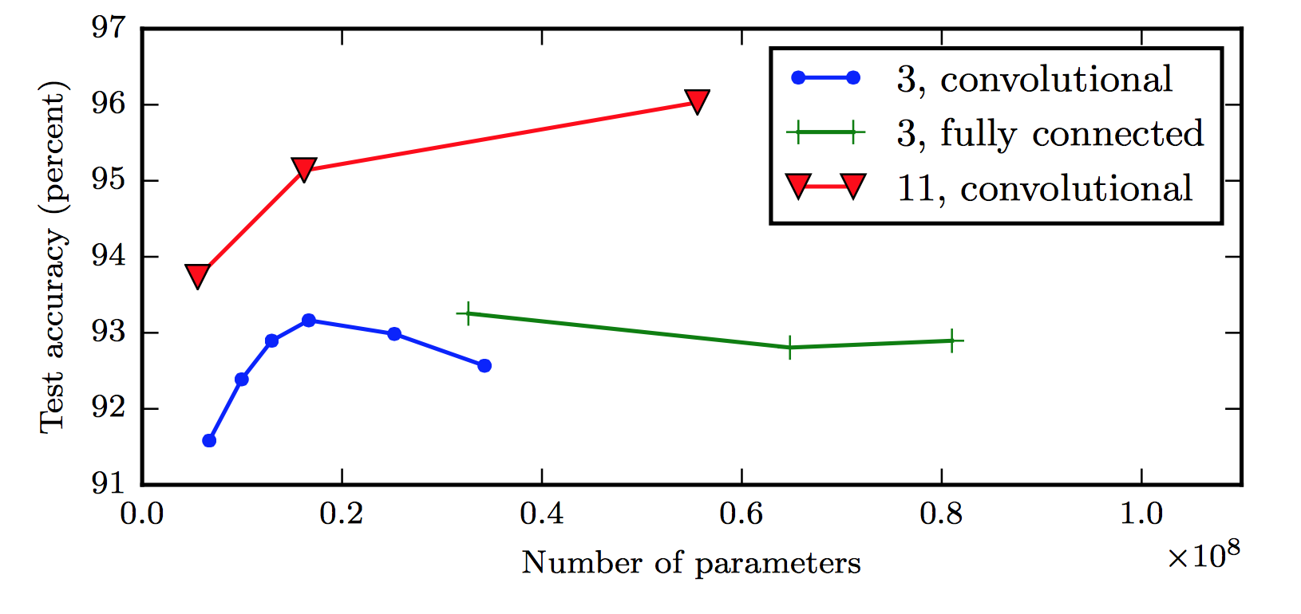
Large, Shallow Nets Overfit More
(Goodfellow 2017)

Slide 29
Design Choices
Cost function
Output units
Hidden units
Architecture
Optimizer

Slide 30
Gradient-based Optimizer (e.g. stochastic gradient descent)
“Chain rule” for computing gradients:
For deeper networks
Naïve computation takes exponential time

Slide 31
Backpropagation
Avoids repeated sub-expressions
Uses dynamic programming (table filling)
Trades-off memory for speed

Slide 32
Backprop: Arithmetic
Jacobian-gradient products
grad w.r.t. x
Jacobian of ‘g’
grad w.r.t. z
Apply recursively!

Slide 33
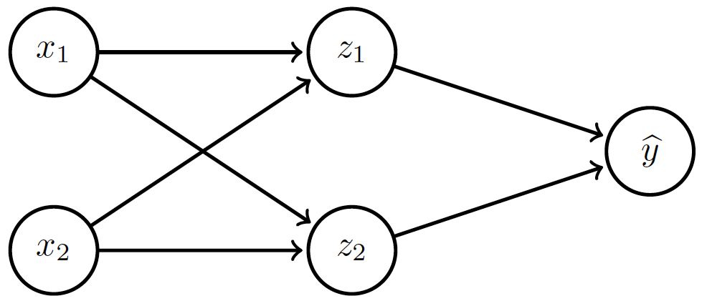
Backprop: Overview
Forward prop: compute activations
Compute loss
Back-prop: compute derivatives

Slide 34
Backprop: Example
Linear activation functions
No bias
Squared loss

Slide 35
Backprop: Example
Forward prop: Propagate activations to output layer

Slide 36
Backprop: Example
Backward prop: Compute loss and its derivative

Slide 37
Backprop: Example
Backward prop: Compute derivatives w.r.t. weights c₁ and c₂

Slide 38
Backprop: Example
Backward prop: Compute derivatives w.r.t. weights c₁ and c₂

Slide 39
Backprop: Example
Backward prop: Propagate derivative to hidden layer

Slide 40
Backprop: Example
Backward prop: Compute derivatives w.r.t. weights a₁, a₂, b₁ and b₂

Slide 41
Backprop: Example
Backward prop: Compute derivatives w.r.t. weights a₁, a₂, b₁ and b₂

Slide 42
Backprop: Example

Slide 43
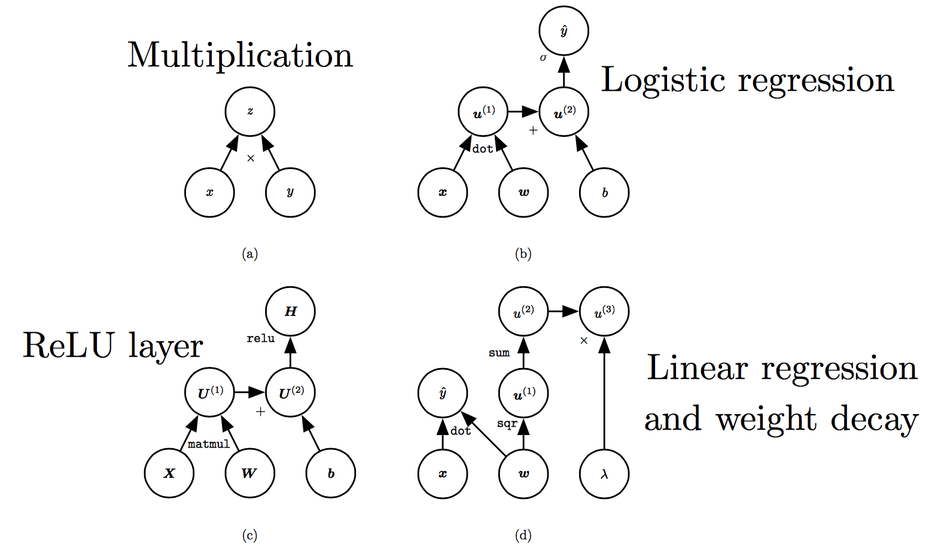
Computation Graphs
(Goodfellow 2017)

Slide 44
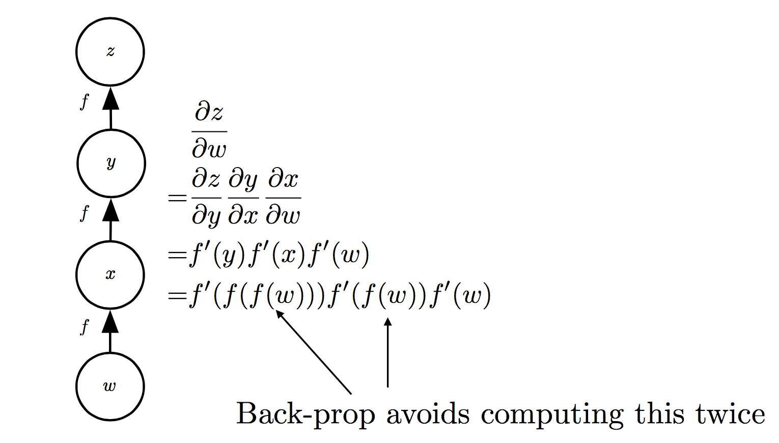
Repeated Sub-expressions
(Goodfellow 2017)

Slide 45
Backprop on Computation Graph
Maintain grad table
Parents of u^{i}

Slide 46
Symbol-to-symbol Differentiation
Derivatives as computation graphs
Same language for both forward and back-propagation
During execution, replace symbolic inputs with numeric value
Used by Theano and TensorFlow
Symbol-to-number differentiation: e.g. Torch and Caffe

Slide 47
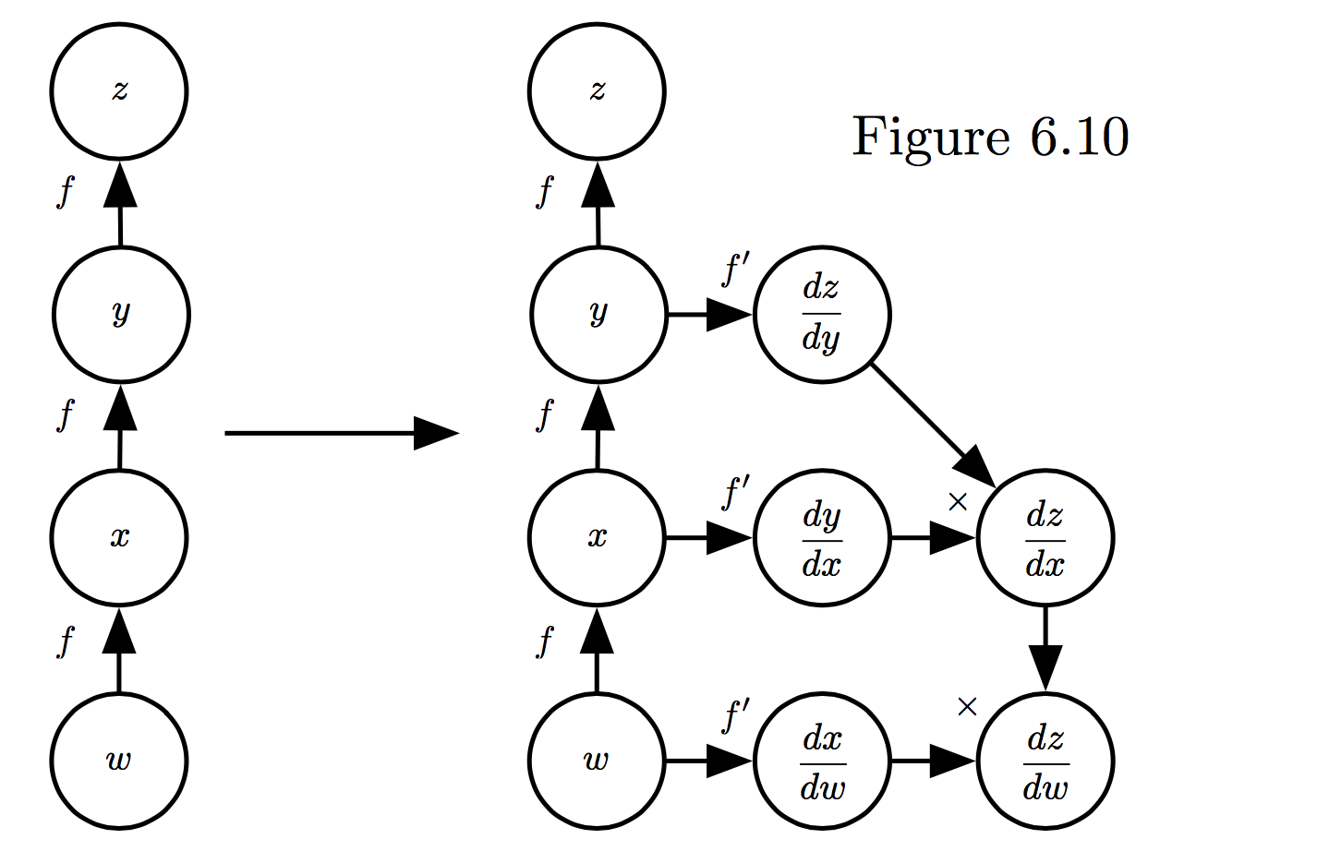
Symbol-to-symbol Differentiation
(Goodfellow et al. 2017)

Slide 48
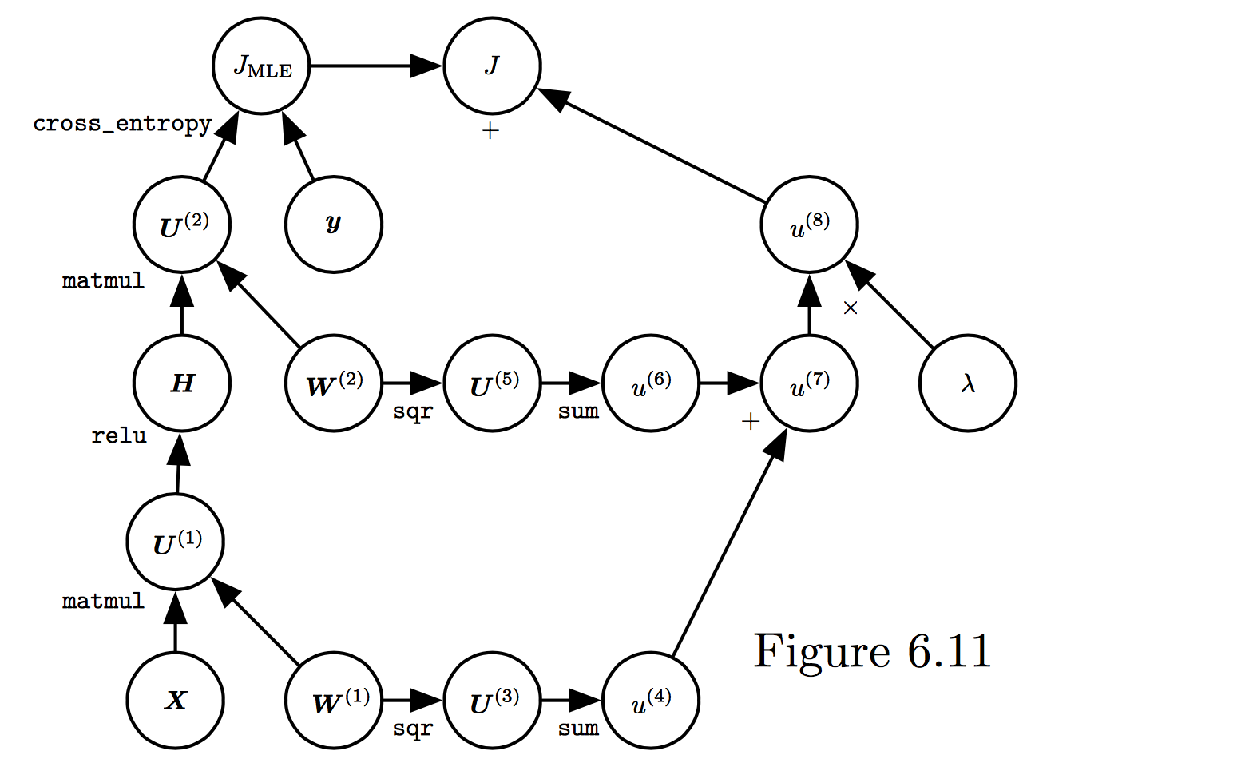
Training Feed-forward Nets
Computational cost for forward/back prop: O(#num-weights)
Memory cost:
O(#num-layers x minibatch-size)
(Goodfellow et al. 2017)

Slide 49
Regularization

Slide 50
Regularization is any modification we make to a learning algorithm that is intended to reduce its generalization error but not its training error

Slide 51
Outline
Norm Penalties
Early Stopping
Data Augmentation
Bagging
Dropout

Slide 52
Outline
Norm Penalties
Early Stopping
Data Augmentation
Bagging
Dropout

Slide 53
Norm Penalties
Optimize:
L₂ regularization:
decays weights
MAP estimation with Gaussian prior
L₁ regularization:
encourages sparsity
MAP estimation with Laplacian prior
Biases not penalized

Slide 54
Norm Penalties as Constraints
Useful if K is known in advance
Optimization:
Construct Lagrangian and apply gradient descent
Projected gradient descent

Slide 55
Outline
Norm Penalties
Early Stopping
Data Augmentation
Bagging
Dropout

Slide 56
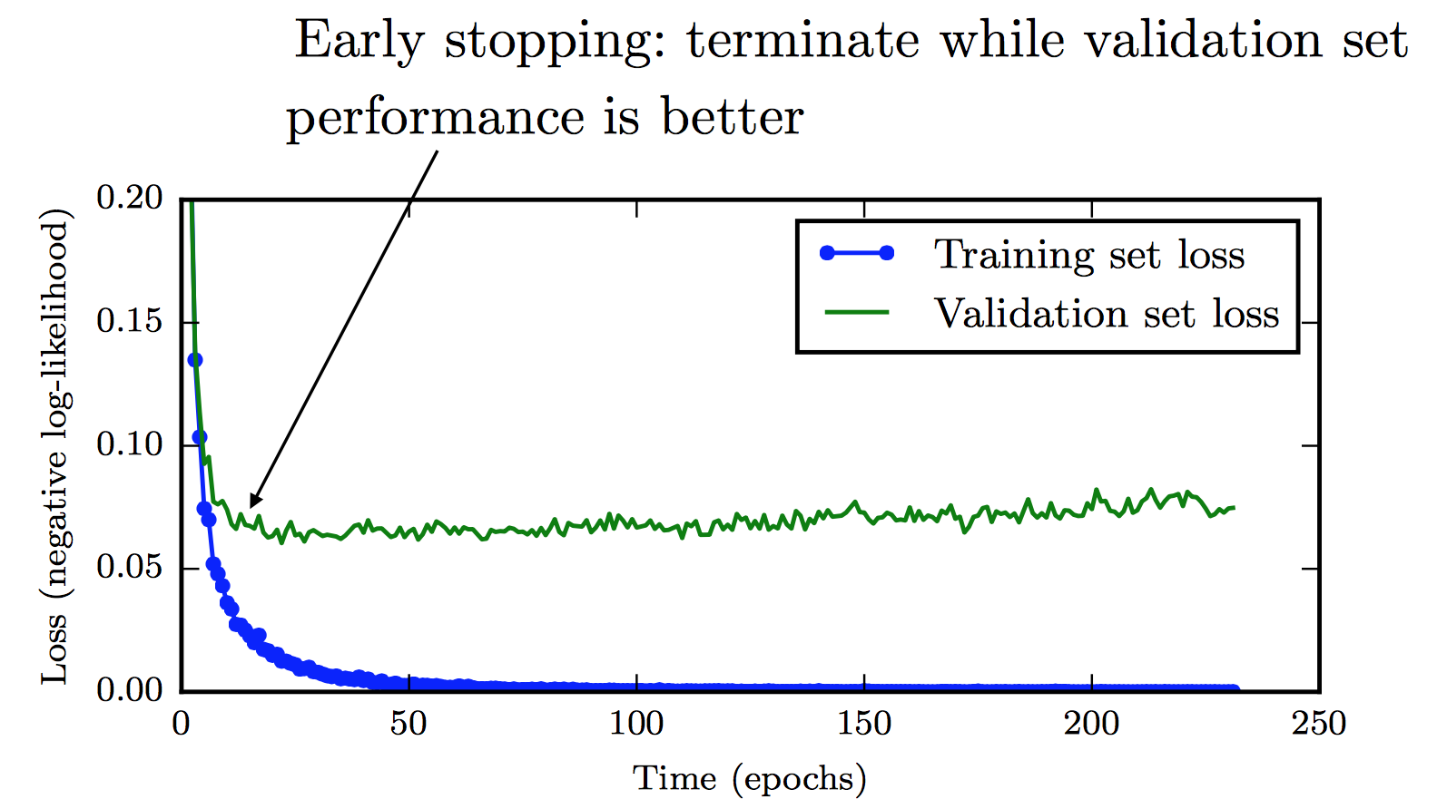
Early Stopping
Training time can be treated as a hyperparameter

Slide 57
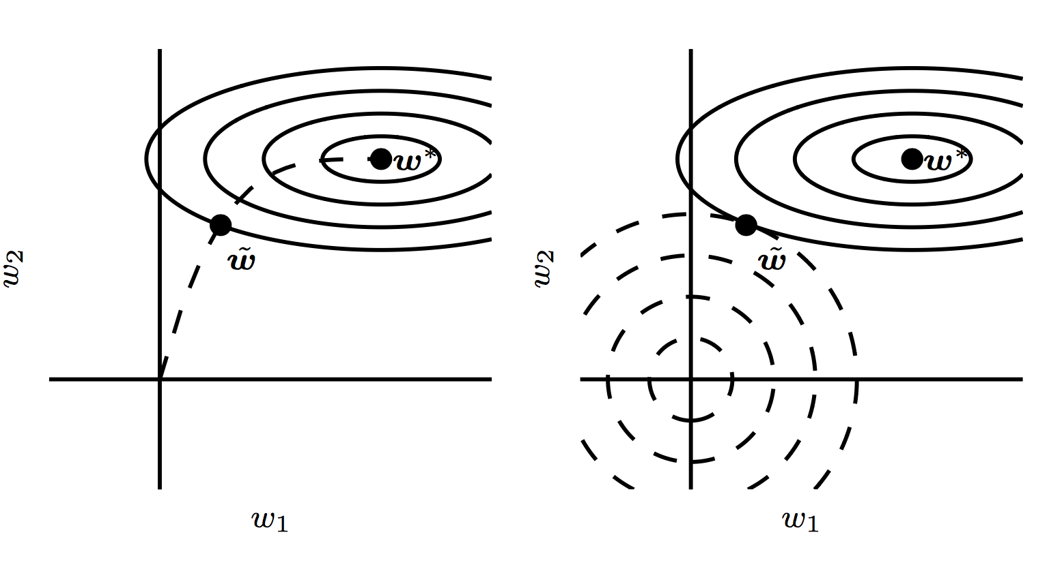
Early Stopping

Slide 58
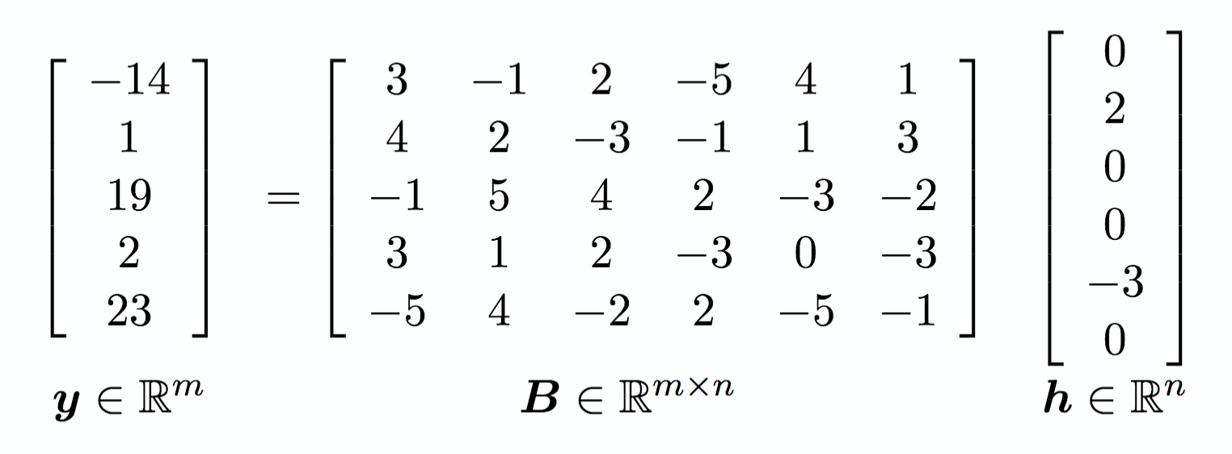
Sparse Representations
Weight decay on activations instead of parameters
Output of hidden layer
Weights in output layer

Slide 59
Outline
Norm Penalties
Early Stopping
Data Augmentation
Bagging
Dropout

Slide 60
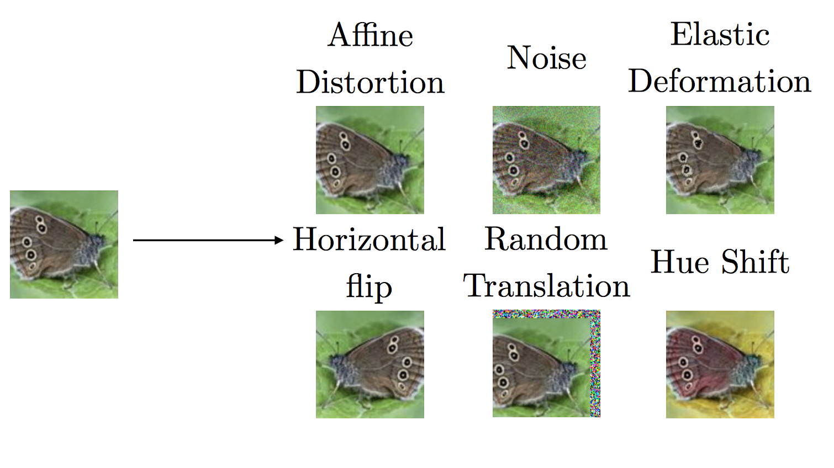
Data Augmentation

Slide 61
Outline
Norm Penalties
Early Stopping
Data Augmentation
Bagging
Dropout

Slide 62
Noise Robustness
Random perturbation of network weights
Gaussian noise: Equivalent to minimizing loss with regularization term
Encourages smooth function: small perturbation in weights leads to small changes in output
Injecting noise in output labels
Better convergence: prevents pursuit of hard probabilities

Slide 63
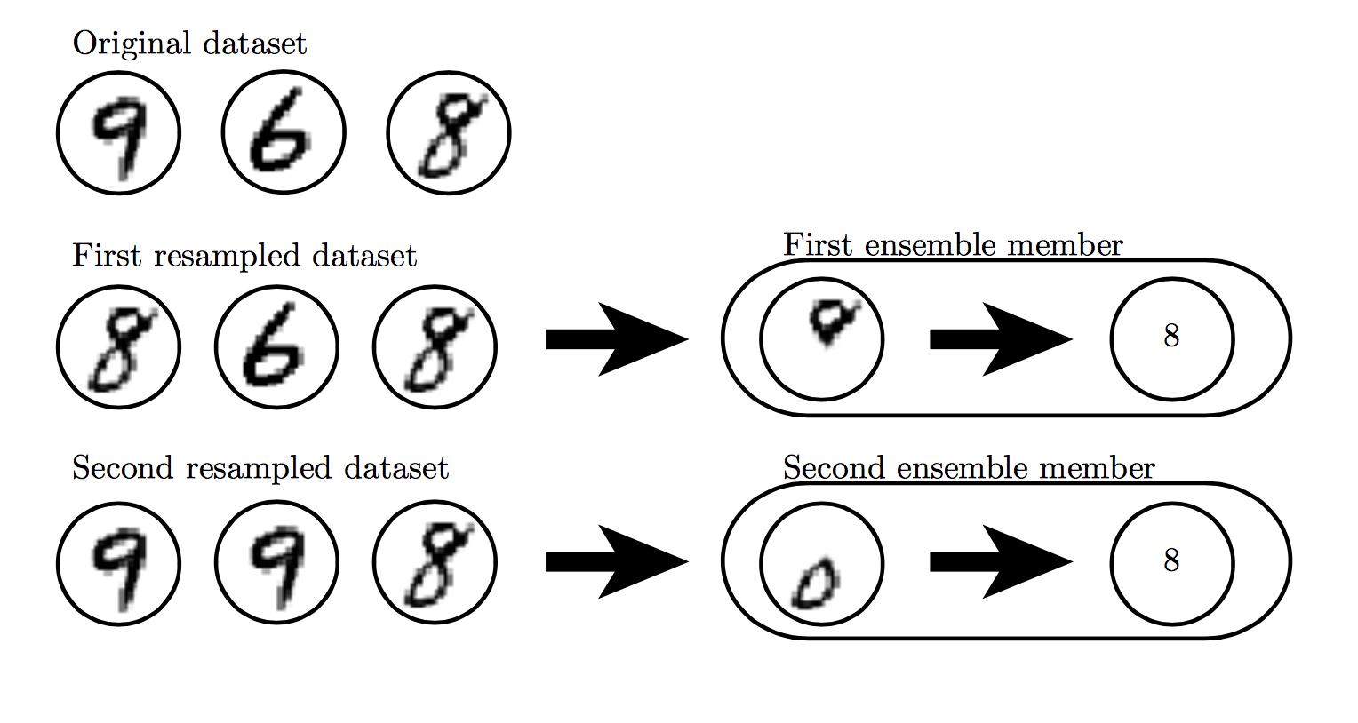
Bagging

Slide 64
Outline
Norm Penalties
Early Stopping
Data Augmentation
Bagging
Dropout

Slide 65
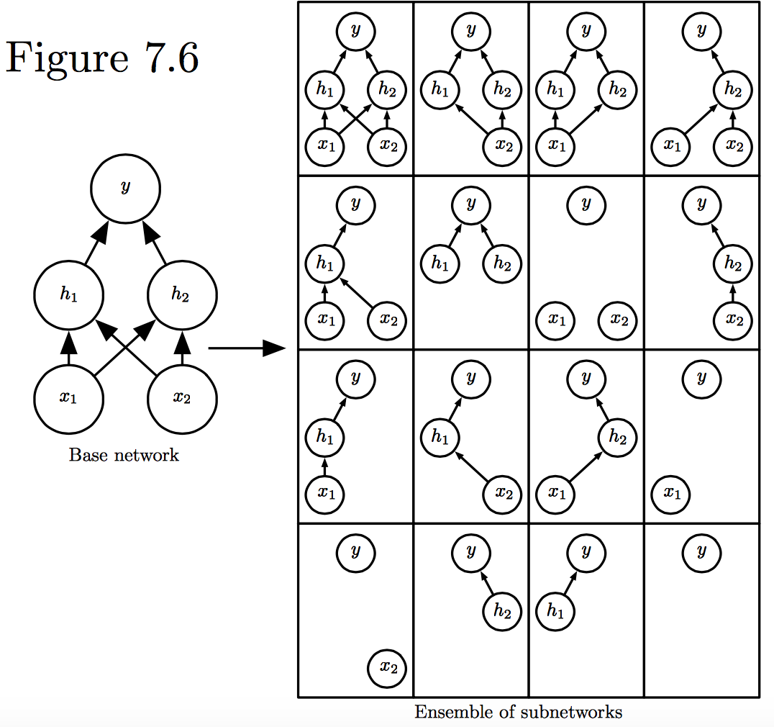
Dropout
Train all sub-networks obtained by removing non-output units from base network

Slide 66
Dropout: Stochastic GD
For each new example/mini-batch:
Randomly sample a binary mask μ independently, where μ_{i} indicates if input/hidden node i is included
Multiply output of node i with μ_{i}, and perform gradient update
Typically, an input node is included with prob=0.8, hidden node with prob=0.5

Slide 67
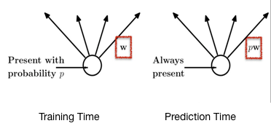
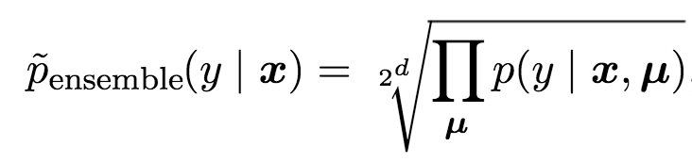
Dropout: Weight Scaling
During prediction time use all units, but scale weights with probability of inclusion
Approximates the following inference rule:
Cristina Scheau (2016)
Notes:
https://chatbotslife.com/regularization-in-deep-learning-f649a45d6e0

Slide 68
Adversarial Examples

Slide 69
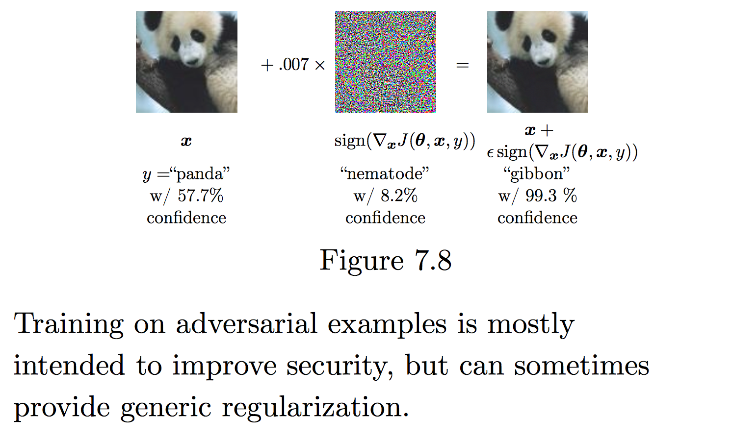
deeplearningbook.org

Slide 70
Multi-task Learning

Slide 71
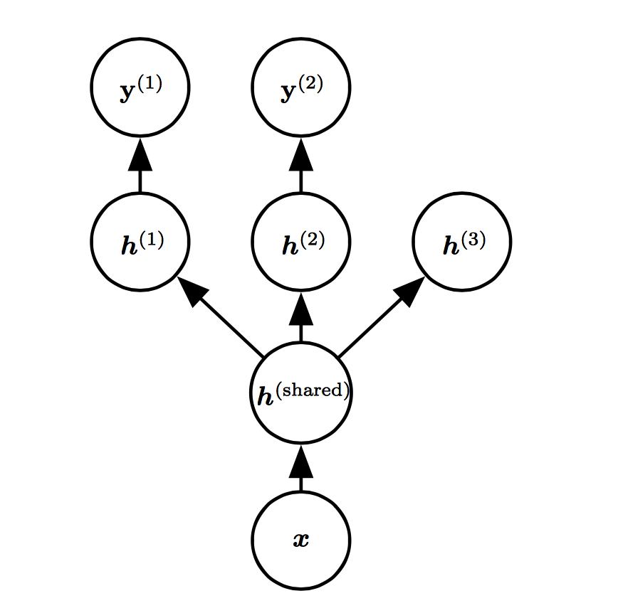
Goodfellow et al. (2016)

Slide 72
Optimization

Slide 73
Learning vs. Optimization
Goal of learning: minimize generalization error
In practice, empirical risk minimization:
Quantity optimized different from the quantity we care about

Slide 74
Batch vs. Stochastic Algorithms
Batch algorithms
Optimize empirical risk using exact gradients
Stochastic algorithms
Estimates gradient from a small random sample
Large mini-batch: gradient computation expensive
Small mini-batch: greater variance in estimate, longer steps for convergence

Slide 75
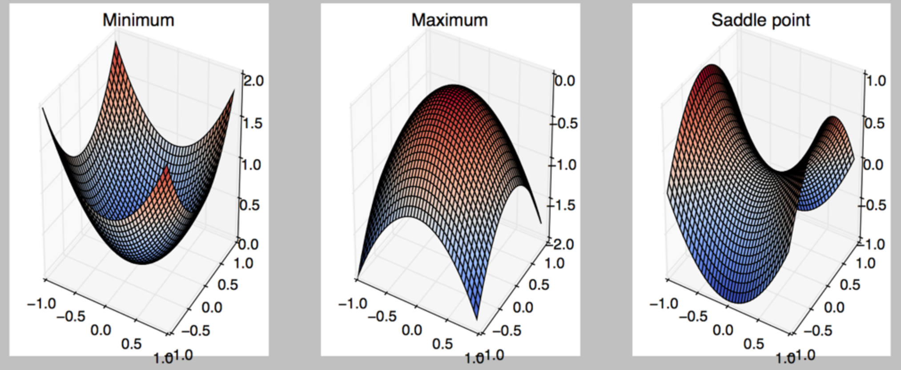
Critical Points
Points with zero gradient
2nd-derivate (Hessian) determines curvature
Goodfellow et al. (2016)

Slide 76
Stochastic Gradient Descent
Take small steps in direction of negative gradient
Sample m examples from training set and compute:
Update parameters:
In practice: shuffle training set once and pass through multiple times

Slide 77
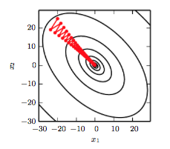
Stochastic Gradient Descent
Oscillations because updates do not exploit curvature information
Goodfellow et al. (2016)

Slide 78
Outline
Challenges in Optimization
Momentum
Adaptive Learning Rate
Parameter Initialization
Batch Normalization

Slide 79
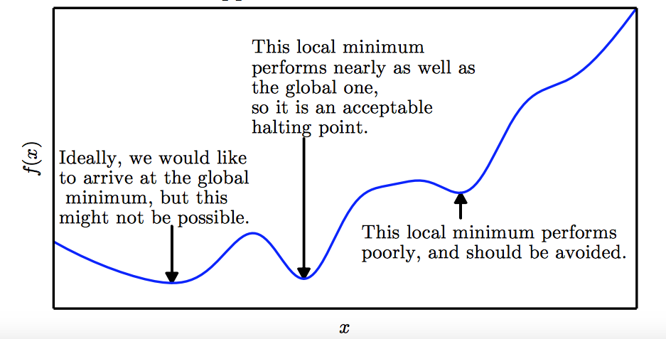
Local Minima
Goodfellow et al. (2016)

Slide 80
Local Minima
Old view: local minima is major problem in neural network training
Recent view:
For sufficiently large neural networks, most local minima incur low cost
Not important to find true global minimum

Slide 81
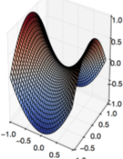
Saddle Points
Both local min and max
Recent studies indicate that in high dim, saddle points are more likely than local min
Gradient can be very small near saddle points
Goodfellow et al. (2016)

Slide 82
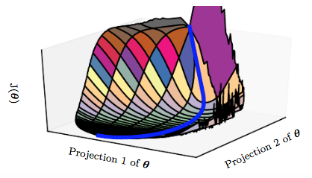
Saddle Points
SGD is seen to escape saddle points
Moves down-hill, uses noisy gradients
Second-order methods get stuck
solves for a point with zero gradient
Goodfellow et al. (2016)

Slide 83
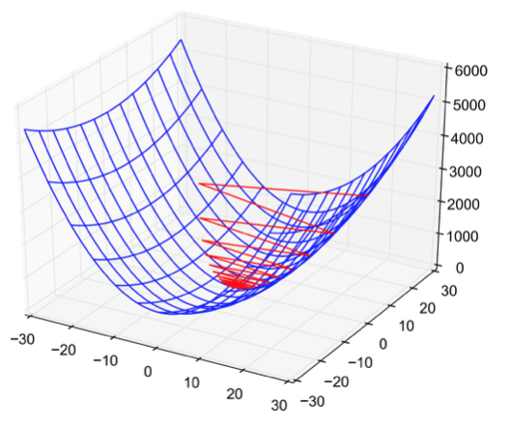
Poor Conditioning
Poorly conditioned Hessian matrix
High curvature: small steps leads to huge increase
Learning is slow despite strong gradients
Oscillations slow down progress

Slide 84
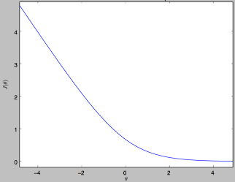
No Critical Points
Some cost functions do not have critical points

Slide 85
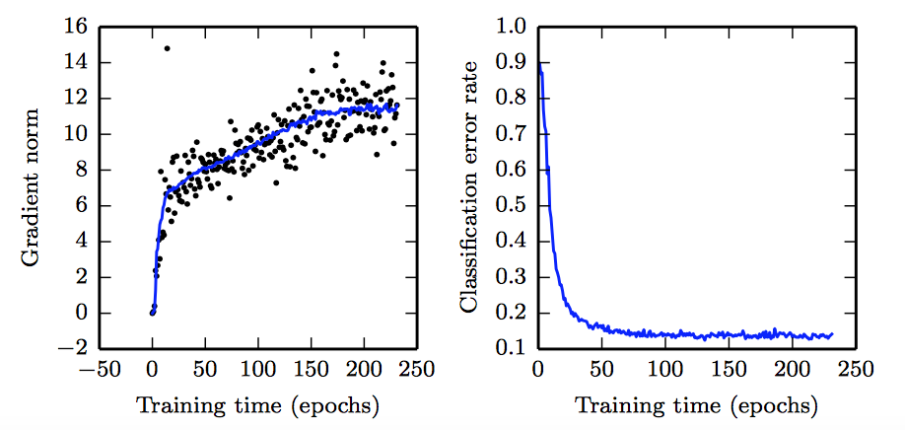
No Critical Points
Gradient norm increases, but validation error decreases
Convolution Nets for Object Detection
Goodfellow et al. (2016)

Slide 86
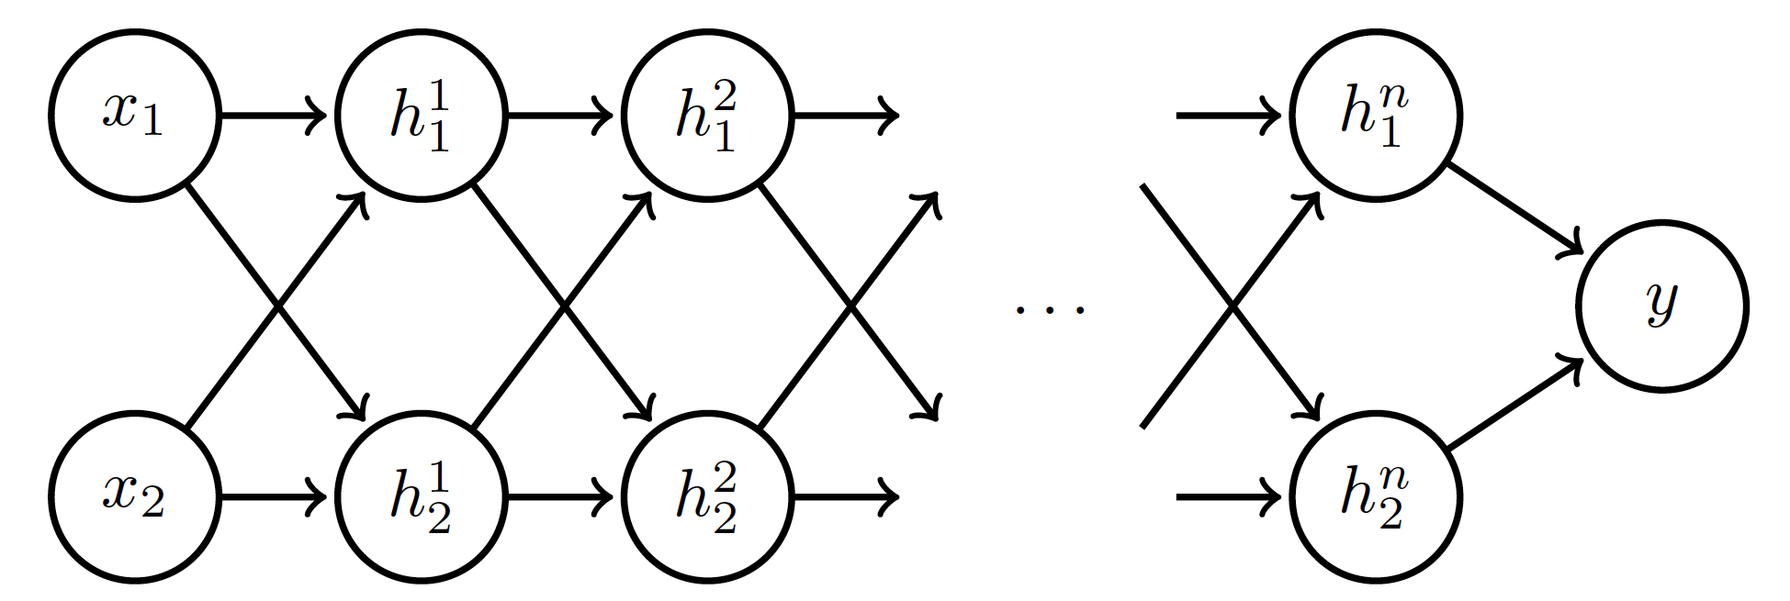
Exploding and Vanishing Gradients
Linear activation
deeplearning.ai

Slide 87
Exploding and Vanishing Gradients

Slide 88
Exploding and Vanishing Gradients
Explodes!
Vanishes!

Slide 89
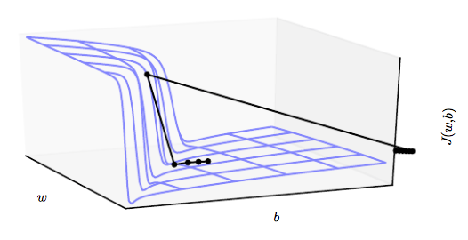
Exploding and Vanishing Gradients
Exploding gradients lead to cliffs
Can be mitigated using gradient clipping
Goodfellow et al. (2016)

Slide 90
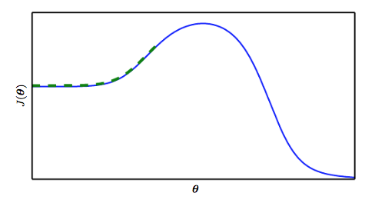
Poor correspondence between local and global structure
Goodfellow et al. (2016)

Slide 91
Outline
Challenges in Optimization
Momentum
Adaptive Learning Rate
Parameter Initialization
Batch Normalization

Slide 92
Momentum
SGD is slow when there is high curvature
Average gradient presents faster path to opt:
vertical components cancel out
Notes:
https://distill.pub/2017/momentum/

Slide 93
Momentum
Uses past gradients for update
Maintains a new quantity: ‘velocity’
Exponentially decaying average of gradients:
Current gradient update
controls how quickly effect of past gradients decay

Slide 94
Momentum
Compute gradient estimate:
Update velocity:
Update parameters:

Slide 95
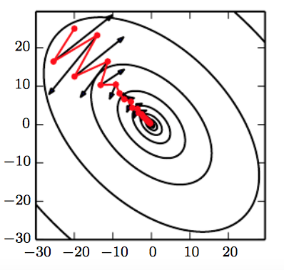
Momentum
Damped oscillations:
gradients in opposite directions get cancelled out
Goodfellow et al. (2016)

Slide 96
Nesterov Momentum
Apply an interim update:
Perform a correction based on gradient at the interim point:
Momentum based on look-ahead slope

Slide 97
Outline
Challenges in Optimization
Momentum
Adaptive Learning Rate
Parameter Initialization
Batch Normalization

Slide 98
Adaptive Learning Rates
Slow
Fast
Oscillations along vertical direction
Learning must be slower along parameter 2
Use a different learning rate for each parameter?

Slide 99
AdaGrad
Accumulate squared gradients:
Update each parameter:
Greater progress along gently sloped directions
Inversely proportional to cumulative squared gradient

Slide 100
RMSProp
For non-convex problems, AdaGrad can prematurely decrease learning rate
Use exponentially weighted average for gradient accumulation

Slide 101
Adam
RMSProp + Momentum
Estimate first moment:
Estimate second moment:
Update parameters:
Also applies bias correction to v and r
Works well in practice, is fairly robust to hyper-parameters

Slide 102
Outline
Challenges in Optimization
Momentum
Adaptive Learning Rate
Parameter Initialization
Batch Normalization

Slide 103
Parameter Initialization
Goal: break symmetry between units
so that each unit computes a different function
Initialize all weights (not biases) randomly
Gaussian or uniform distribution
Scale of initialization?
Large -> grad explosion, Small -> grad vanishing

Slide 104
Xavier Initialization
Heuristic for all outputs to have unit variance
For a fully-connected layer with m inputs:
For ReLU units, it is recommended:

Slide 105
Normalized Initialization
Fully-connected layer with m inputs, n outputs:
Heuristic trades off between initialize all layers have same activation and gradient variance
Sparse variant when m is large
Initialize k nonzero weights in each unit

Slide 106
Bias Initialization
Output unit bias
Marginal statistics of the output in the training set
Hidden unit bias
Avoid saturation at initialization
E.g. in ReLU, initialize bias to 0.1 instead of 0
Units controlling participation of other units
Set bias to allow participation at initialization

Slide 107
Outline
Challenges in Optimization
Momentum
Adaptive Learning Rate
Parameter Initialization
Batch Normalization

Slide 108
Feature Normalization
Good practice to normalize features before applying learning algorithm:
Features in same scale: mean 0 and variance 1
Speeds up learning
Feature vector
Vector of mean feature values
Vector of SD of feature values

Slide 109
Feature Normalization
Before normalization
After normalization

Slide 110
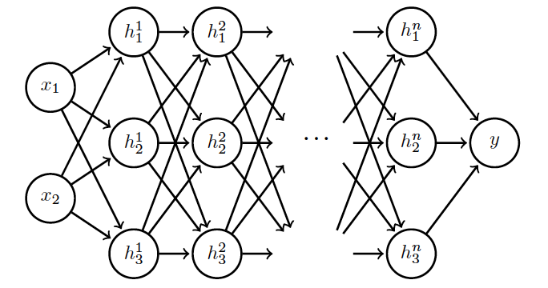
Internal Covariance Shift
Each hidden layer changes distribution of inputs to next layer: slows down learning
…
Normalize inputs to layer 2
Normalize inputs to layer n

Slide 111
Batch Normalization
Training time:
Mini-batch of activations for layer to normalize
K hidden layer activations
N data points in mini-batch

Slide 112
Batch Normalization
Training time:
Mini-batch of activations for layer to normalize
where
Vector of mean activations across mini-batch
Vector of SD of each unit across mini-batch

Slide 113
Batch Normalization
Training time:
Normalization can reduce expressive power
Instead use:
Allows network to control range of normalization
Learnable parameters

Slide 114
Batch Normalization
Batch 1
…..
Add normalization operations for layer 1
Batch N

Slide 115
Batch Normalization
Batch 1
…..
Add normalization operations for layer 2 and so on …
Batch N

Slide 116
Batch Normalization
Differentiate the joint loss for N mini-batches
Back-propagate through the norm operations
Test time:
Model needs to be evaluated on a single example
Replace μ and σ with running averages collected during training

